Slide 1
Two Dimensional Array

Slide 2
Introduction
The two-dimensional array can be defined as an array of arrays.
The two dimensional (2D) array in C programming is also known as matrix. A matrix can be represented as a table of rows and columns.

Slide 3
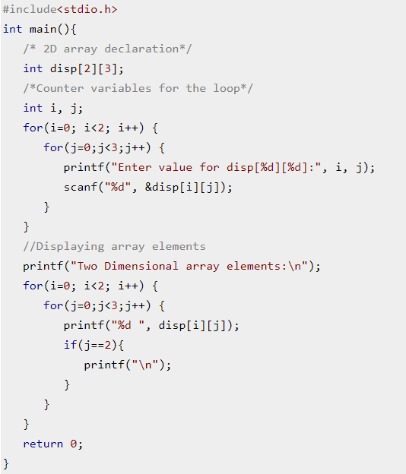
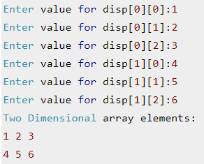
Example

Slide 4
Address of 2D array
X[3][3] | Column 0 | Column 1 | Column 2
Row 0 | X[0][0] | X[0][1] | X[0][2]
Row 1 | X[1][0] | X[1][1] | X[1][2]
Row 2 | X[2][0] | X[2][1] | X[2][2]
As 2-D array is stored in row major order in C language, row 0 will be stored first followed by row 1 and row 2. For finding the address of x[2][2], we need to go to 2nd row (each row having 3 elements). After reaching 2nd row, it can be accessed as single dimensional array. Therefore, we need to go to 2nd element of the array. Assuming Base address (BA) as 0 and size as 1, the address of x[2][2] will be 0 + (2 * 3 + 2) * 1 = 8.
For a given array with m rows and n columns, the address can be calculated as:
add(a[i][j]) = BA + (i*n + j) * SIZE

Slide 5
Example
Assuming that the main memory is byte-addressable and that the array is stored starting from memory address 0, the address of a[40][50] is: (GATE CS 2002)
addr[40][50] = 0 + (40*100 + 50) * 1 = 4050

Slide 6
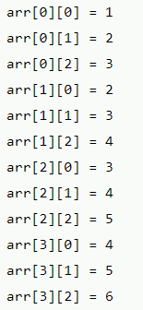
2D array declaration
#include<stdio.h>
int main(){
int i=0,j=0;
int arr[4][3]={{1,2,3},{2,3,4},{3,4,5},{4,5,6}};
//traversing 2D array
for(i=0;i<4;i++){
for(j=0;j<3;j++){
printf("arr[%d] [%d] = %d \n",i,j,arr[i][j]);
}//end of j
}//end of i
return 0;
}

Slide 7
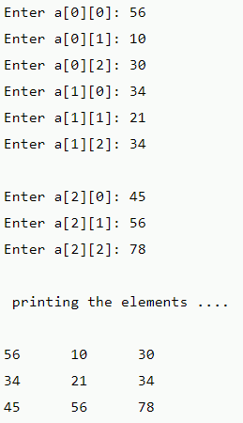
#include <stdio.h>
void main ()
{
int arr[3][3],i,j;
for (i=0;i<3;i++)
{
for (j=0;j<3;j++)
{
printf("Enter a[%d][%d]: ",i,j);
scanf("%d",&arr[i][j]);
}
}
printf("\n printing the elements ....\n");
for(i=0;i<3;i++)
{
printf("\n");
for (j=0;j<3;j++)
{
printf("%d\t",arr[i][j]);
}
}
}

Slide 8
Problems on array
Input a metrix Transpose it using 2D array.
To add substract and multiply two matrices.
Program to input matrix and print its diagonals.
Web references:
https://www.includehelp.com/c-programs/c-programs-two-dimensional-array-or-matrix-programs.aspx
https://www.javatpoint.com/two-dimensional-array-in-c
https://www.youtube.com/watch?v=J1aQ9JN4vZY
https://www.youtube.com/watch?v=jzdQqoG1tZs
https://www.youtube.com/watch?v=aAFP5wsmH2k

